Slide 1

RNA-Seq in GenePattern

Slide 2


RNA-Seq Differential Expression Analysis Workflow
Raw sequence reads (FASTQ format)
Quality Control Checking
FastQC
Trimming / Filtering
Trimmomatic
Read Alignment
TopHat
GenePattern modules
Summarization / Quantitation
Cuffdiff
Normalization
Differential Expression Analysis
Visualization
Notes:
So, to pick up where we left off – we’ve assessed the initial quality of our data and determined that it has an adaptor sequence which is over represented, and thus needs to be trimmed.

Slide 3
Run Trimmomatic on paired FASTQ files
We use Trimmomatic to trim contaminating adapter sequences.
We discard reads if they are below a specified length after trimming.
adapter
read
Before trimming
genome
read
After trimming
✗
genome
Output files:
_1P or _2P are forward and reverse reads which both passed quality checks ✓
_1U or _2U are “unpaired” reads in which one of the pair did not pass ✗
http://www.usadellab.org/cms/?page=trimmomatic
Notes:
To remove these adapters, we will use Trimmomatic. This will go through all the reads in our data and remove the specific adapter sequence. Then, it will double-check the length of the remainder of the read – if it’s too short, the read is discarded.
To run Trimmomatic, we find it in the GenePattern modules

Slide 4
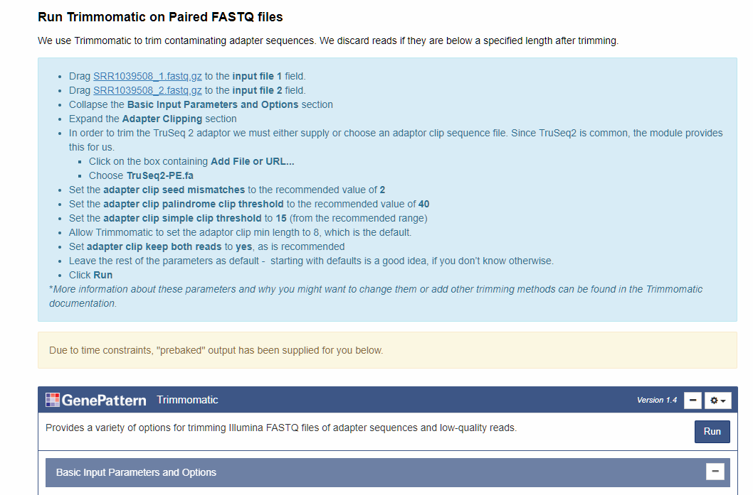
Run Trimmomatic on paired FASTQ files FA

Slide 5
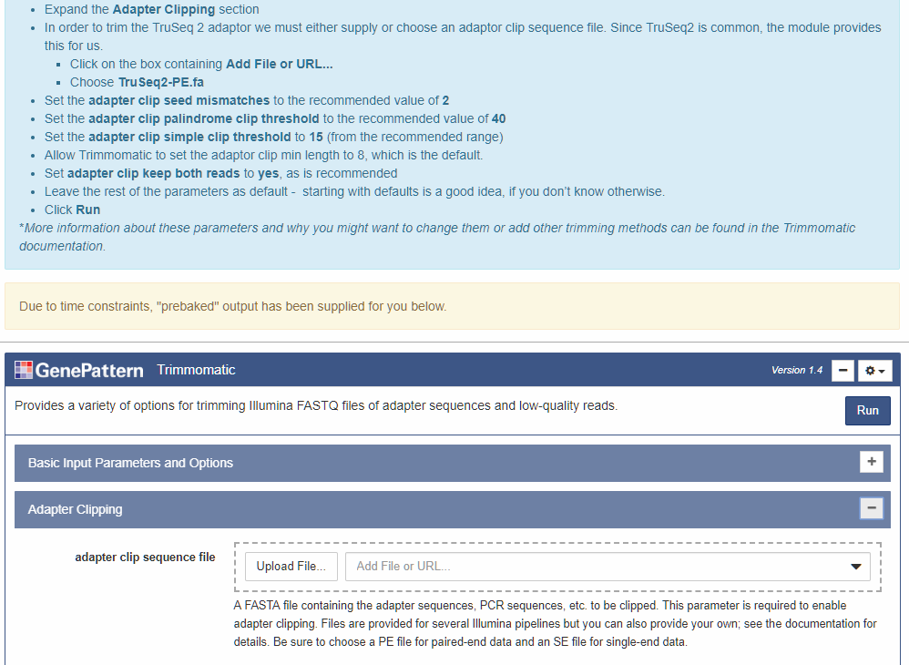
Run Trimmomatic on paired FASTQ files FA
Notes:
In order to trim the TruSeq 2 adaptor we must either supply or choose an adaptor clip sequence file. Since TruSeq2 is common, the module provides this for us.
We will set the clip seed mismatch to the recommended value of 2, the adaptor clip palindrome clip threshold to the recommended value of 40, the adaptor clip simple clip threshold to 15 (from the recommended range), and allow Trimmomatic to set the adaptor clip min length to 8, which is the default. Lastly we will clip both reads, as is recommended.
More information about these parameters and why you might want to change them or add other trimming methods can be found in our documentation.
For today, the take home message is that starting with defaults is a good idea, if you don’t know otherwise.
You would then click run – but this job will take 20-30 minutes to complete, per paired read, so we’ll look at a prebaked result

Slide 6
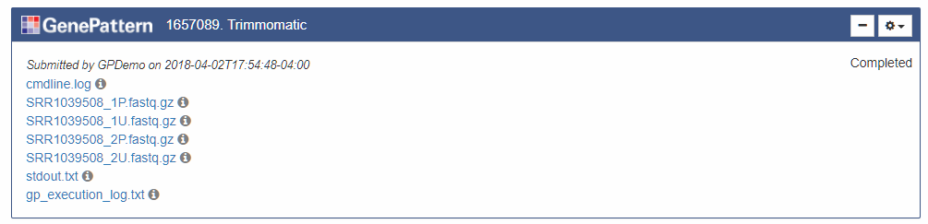
Trimmomatic results | FA
Notes:
Let’s look at the “prebaked” example job. Here you can see all the outputs of the job
As a reminder (show next slide)

Slide 7
Trimmomatic on paired FASTQ files
We use Trimmomatic to trim contaminating adapter sequences.
We discard reads if they are below a specified length after trimming.
adapter
read
Before trimming
genome
read
After trimming
✗
genome
Output files:
_1P or _2P are forward and reverse reads which both passed quality checks ✓
_1U or _2U are “unpaired” reads in which one of the pair did not pass ✗
http://www.usadellab.org/cms/?page=trimmomatic
Notes:
The output files we want are the _1P/_2P files which passed both of the quality checks.
(FA) If we click on of those files it will open a menu where we can send the file to FastQC to see if trimming that adaptor sequence improved our results.

Slide 8
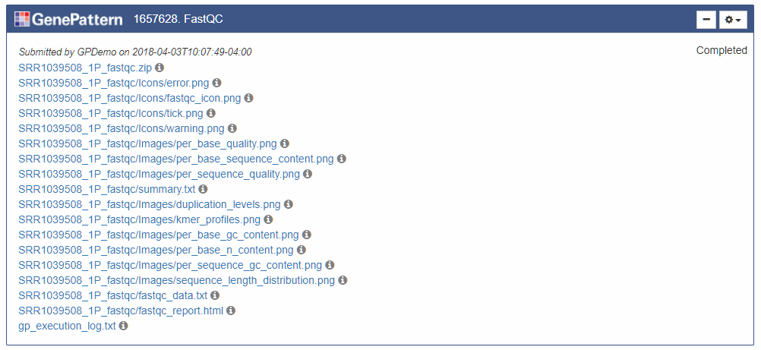
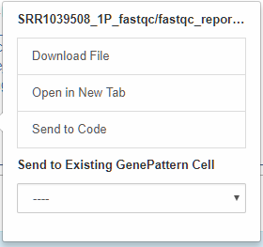

FastQC re-run results | FA
Notes:
Look at example job
Once again, we are interested in the report file.

Slide 9
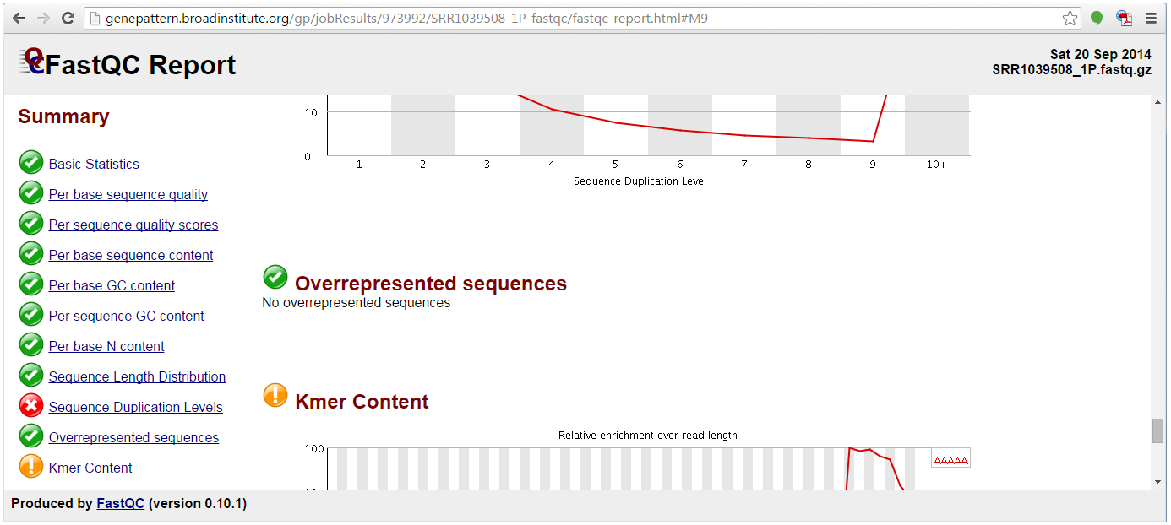
Re-run FastQC to see improvement
If we re-run FastQC after trimming adapter sequences using Trimmomatic, we can see that the quality of the reads has improved.
Notes:
Once we’ve run Trimmomatic, we can check to see if the quality of our reads has improved. If we re-run FastQC on all samples as before, we can see that the ‘overrepresented sequences’ metric, which was previously orange, is now green and the issue has been resolved.
For the error – sequence duplication levels, we appear to have some sequences that appear repeatedly in the samples. This can be due to technical duplicates arising from PCR artifacts, or biological duplicates which are natural collisions where different copies of exactly the same sequence are randomly selected. From a sequence level there is no way to distinguish between these two types and both will be reported as duplicates here.
A warning or error in this module is simply a statement that you have exhausted the diversity in at least part of your library and are re-sequencing the same sequences. Some library types naturally over-sequence parts of the library and therefore generate duplication and will therefore expect to see warnings or error from this module.
(IE – you will rarely if ever see them all green)

Slide 10
RNA-Seq Differential Expression Analysis Workflow
Raw sequence reads (FASTQ format)
Quality Control Checking
FastQC
Trimming / Filtering
Trimmomatic
Read Alignment
TopHat
GenePattern modules
Summarization / Quantitation
Cuffdiff
Normalization
Differential Expression Analysis
Visualization
Notes:
Once we’ve evaluated the quality of our reads and are satisfied, we can now align the reads to a reference genome.

Slide 11
RNA-Seq Differential Expression Analysis Workflow
Alignment & Downstream Analyses
How many reads successfully aligned?
Where did the reads align?
Are there differences in the number of reads for each phenotype?
Can I visualize the differences in phenotypes?
Notes:
As we mentioned at the beginning - As we progress through RNA-seq analysis, we are looking to answer several questions. The first question is – what does my data look like? Does it look approximately the way most RNA-seq data looks, or are there significant issues which suggest a problem with the sequencing? Are there biases toward 3’ or 5’ ends, different bases, different sequences?
Once we’ve determined our data is approximately normal, then we can proceed with alignment and downstream analyses. Then, we are asking other questions, such as – how did my data align? How many of the reads aligned? Are there visual differences between the phenotypes?

Slide 12
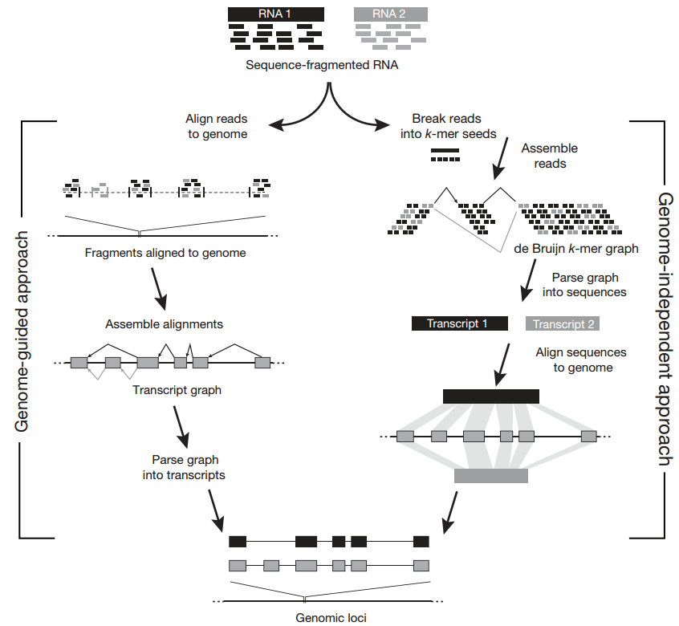
Run TopHat to align reads
TopHat is an alignment tool which can be used to align sequence reads to a genome or transcriptome.
Align reads to genome
Sequence reads
Fragments aligned to genome
Assemble alignments
Parse graph into transcripts
Transcript graph
Genomic loci
Garber et al. (2011) Doi:10.1038/nmeth.1613
Notes:
TopHat can be used in a few different modes. We will use TopHat to do a guided alignment. This uses a genome or transcriptome to guide the alignment of the reads. Here, the read fragments are aligned to the genome, and then transcripts are assembled from the aligned reads. This is the least computationally intensive mode in which to run TopHat.

Slide 13
Run TopHat to align reads
Aligning to the transcriptome with TopHat requires either a genome annotation file (GTF file), or a transcriptome index. We will use the UCSC hg19 reference annotation.
Step 1. Create a transcriptome index.
To speed up alignment, we create a transcriptome index by running the UCSC hg19 reference annotation on its own.
Step 2. Align reads to the transcriptome.
We align the reads to the transcriptome using the transcriptome index created in Step 1. We run TopHat for each sample (8 times).
This is the least computationally intensive mode to run TopHat; however, alignment will take >1 hour per sample.

Slide 14
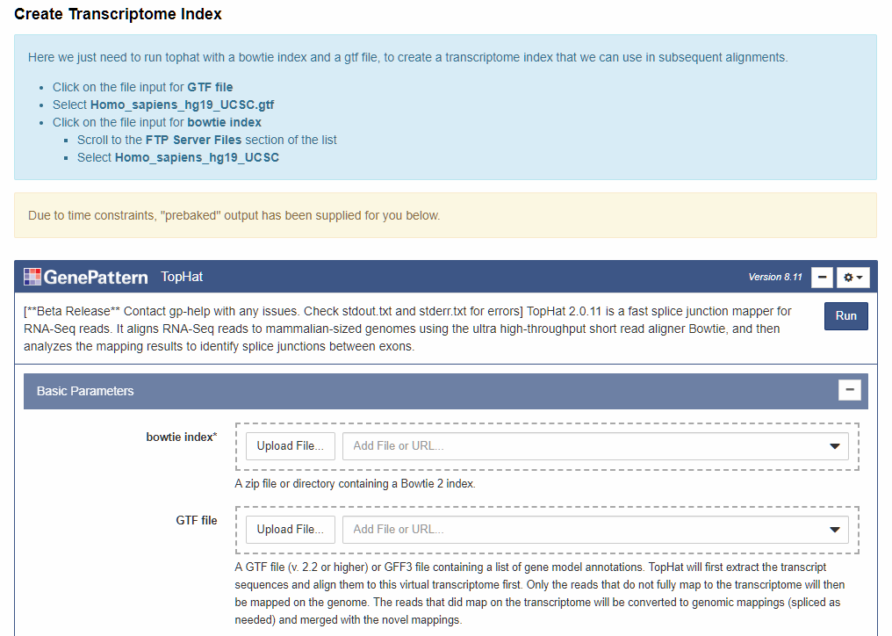
Run TopHat to create a transcriptome index | FA
Notes:
FA in Notebook
Here we just need to run tophat with a bowtie index and a gtf file, to create a transcriptome index that we can use in subsequent alignments.
As a reminder, you do not need to submit the job, as each job will take over an hour to run – the outputs will be provided for you in downstream analysis in this workshop

Slide 15
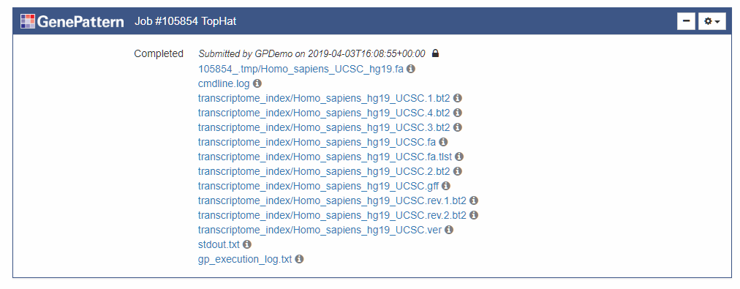
Run TopHat to create a transcriptome index | FA
Index = the whole transcriptome_index folder:
https://genepattern.broadinstitute.org/gp/jobResults/105854/transcriptome_index
Notes:
The output will be a folder of different files that can be used as the reference for alignment.
I’ve provided it for drag and drop in the notebook

Slide 16
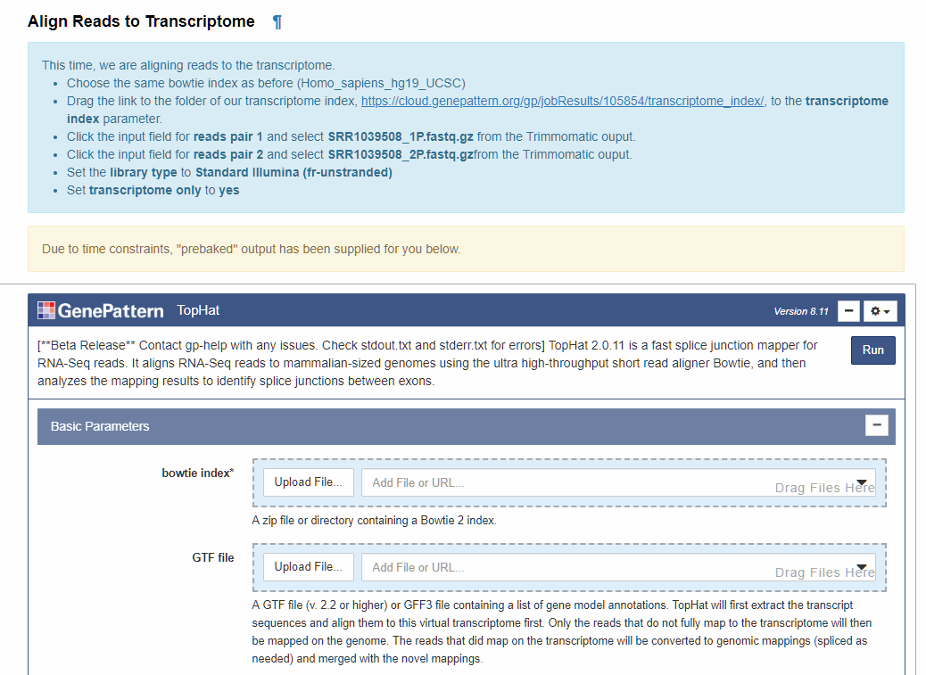
Run TopHat to align reads | FA
Notes:
Next, we run tophat again, this time to align our reads to the transcriptome, using the index we just created to speed up the process.
.

Slide 17
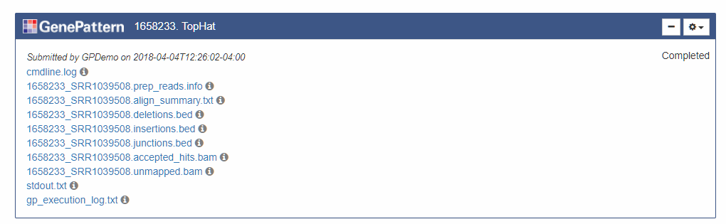
TopHat results | FA
The important output is the *.accepted_hits.bam file. Remember that BAM files are not human readable (we will not be able to view it).
Notes:
You can see here there are a lot of files, but the one we’re interested in is called the filename, followed by accepted_hits.bam. Note that it’s a BAM file, so downloading and opening this file will not be possible – it’s computer-readable, not human-readable. Also note that this is only the accepted hits. We’re not interested in the unmapped reads, or in the summary information about insertions, deletions, etc. We just want to know which reads mapped.

Slide 18
RNA-Seq Differential Expression Analysis

Slide 19
RNA-Seq Differential Expression Analysis Workflow
Raw sequence reads (FASTQ format)
Quality Control Checking
FastQC
Trimming / Filtering
Trimmomatic
Read Alignment
TopHat
GenePattern modules
Summarization / Quantitation
Cuffdiff
Normalization
Differential Expression Analysis
Visualization
Notes:
We’re going to learn more about differential expression analysis using the Cufflinks suite.

Slide 20
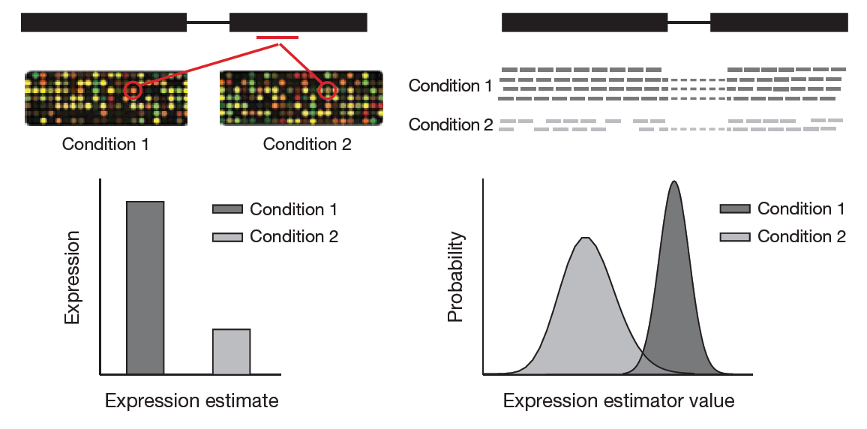
Differential gene expression analysis
Microarray
RNA-Seq
Garber et al. (2011) Doi:10.1038/nmeth.1613
Notes:
Differential gene expression analysis is trying to determine what the expression of a gene is, at the gene level, and usually is trying to compare phenotypes. For instance, we might want to know what happens to a gene like P53 in a normal sample versus a tumor sample – is it overexpressed, underexpressed? In microarrays, you can compare the direct levels of expression for each probe. For RNA-seq data, you compare the distribution of reads across the different phenotypes.

Slide 21
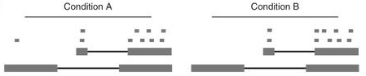
Differential gene expression analysis
Summarization/quantitation accurately derives expression values by assigning reads to the most likely transcription template.
Raw count: map reads to exons and divide by a scaling factor based on the length of the exons
Condition A
Condition B
10
10
Exon: A B C A B C
Notes:
There are two basic ways to do differential expression analysis of RNA-seq data that we’ll touch on today. The first and most straightforward is based on raw count data, like DESeq. This looks at a specific region, such as an entire gene, or an exon, and it just simply counts how many reads have piled up in that region. It also scales based on the length of the exon.
The raw count method is simple, effective and fast, but it runs into problems when a gene has an isoform, because it cannot differentiate between isoforms. Here we have three exons, A, B and C. We have two isoforms. The top isoform is transcribed from B and C, the bottom isoform is transcribed from A and C. The raw count method simply counts the number of dots piled up, and it cannot tell if the reads map to the top isoform or the bottom isoform.

Slide 22
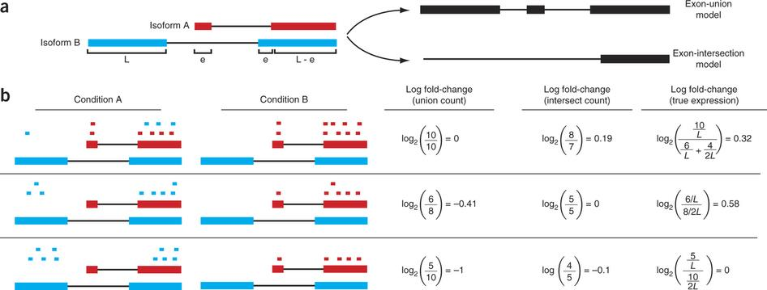
Differential gene expression analysis
Summarization/quantitation accurately derives expression values by assigning reads to the most likely transcription template.
Raw count: map reads to exons and divide by a scaling factor based on the length of the exons
Condition A
Condition B
4 vs 6
10
Exon: A B C A B C
Notes:
If we look at the individual reads, we see that instead of 10 and 10, we actually have 4/6, versus 10. So in a raw count method the assumption is that the expression of the red isoform is no different than the blue.

Slide 23
Differential gene expression analysis
Summarization/quantitation accurately derives expression values by assigning reads to the most likely transcription template.
Raw count: map reads to exons and divide by a scaling factor based on the length of the exons
true expression
union count
intersection count
—
↑
↑↑
↓
—
↑
↓↓
↓
—
Notes:
In the top row, the gene generates the same number of reads in conditions A and B, but in condition B, all of the reads come from the shorter of the two isoforms, and thus the true expression for the gene is higher in condition B.
The intersection count scheme underestimates the true change in gene expression (it sees it as only slightly higher), and the union scheme fails to detect the change entirely.
In the middle row, the intersection count fails to detect a change driven by a shift in the dominant isoform for the gene. The union scheme detects a shift in the wrong direction.
In the bottom row, the gene's expression is constant, but the isoforms undergo a complete switch between conditions A and B.
Both simplified counting schemes register a change in count that does not reflect a change in gene expression.

Slide 24
Differential gene expression analysis
Summarization/quantitation accurately derives expression values by assigning reads to the most likely transcription template.
Isoform deconvolution: estimate the expression levels of a gene’s alternative isoforms (transcripts) and then sum those transcript-level estimates to derive gene-level expression estimates.
Paired ends increase isoform deconvolution confidence.
P₁
P₂
P₃
P₁ is from I₁, I₂ or I₃.
P₂ is from I₁.
P₃ is from I₁ or I₂.
Isoform 1
Isoform 2
Isoform 3
Notes:
The other method for evaluating differential expression is to use isoform deconvolution methods, like Cuffdiff. This looks at the expression from different exons, and calculates the probability of a read mapping to an isoform. One thing to note is that isoform deconvolution methods greatly benefit from paired end reads, because the pairs allow better identification of which exons reads map to, which improves the probability of assigning reads to an isoform.

Slide 25
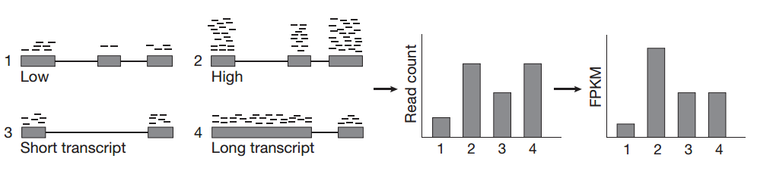
How to quantify expression from reads
Garber et al. (2011) Doi:10.1038/nmeth.1613
Notes:
Cuffdiff will summarize, normalize, and quantitate reads and try to determine differential expression analysis. One thing to keep in mind is how the expression values are calculated.
When comparing 1 to 2, it’s clear there are many more reads in 2 than in 1, even across the same regions. Therefore 2 is clearly higher than 1.

Slide 26
How to quantify expression from reads
Garber et al. (2011) Doi:10.1038/nmeth.1613
Notes:
Cuffdiff will summarize, normalize, and quantitate reads and try to determine differential expression analysis. One thing to keep in mind is how the expression values are calculated.
When comparing 1 to 2, it’s clear there are many more reads in 2 than in 1, even across the same regions. Therefore 2 is clearly higher than 1.
However, RNA fragmentation during library construction causes longer transcripts to generate more reads compared to shorter transcripts present at the same abundance in the sample, so we have to account for transcript length as well.

Slide 27
How to quantify expression from reads
Fragments Per Kilobase of transcript per Million mapped reads (FPKM), a count of mapped fragments normalized to transcript length.
Garber et al. (2011) Doi:10.1038/nmeth.1613
Notes:
Therefore we must use a new metric, FPKM – fragments per kilobase of transcript per million mapped reads. This normalizes the count of mapped reads by the length of the transcript, to provide an accurate estimate of expression. Based on this, we can see that 3 and 4 actually have similar levels of expression. In contrast, 1 has low expression and 2 has very high expression, because the length is the same.

Slide 28
Exercise
Notes:
Next we’ll use the CuffDiff module to do the actual differential expression analysis.

Slide 29
Run Cuffdiff to differentiate phenotypes
Cuffdiff summarizes, normalizes, and quantitates aligned read data. It can also conduct differential expression analysis.
First, we group aligned reads from TopHat condition (untreated vs. dex).
Then, we identify genes which are differentially expressed by comparing the two conditions.
Notes:
Cuffdiff will summarize, normalize, and quantitate reads and try to determine differential expression analysis. One thing to keep in mind is how the expression values are calculated.
Apps vs website – sometimes more/better features in one vs the other – app on a phone vs a website
Another feature that is part of the WebApp, but not yet in the notebooks, is the ability to describe different groups or, in this case, conditions. So we will go back to the GenePattern server WebApp to construct this job.
Though, for today we will not run the job – Bugs, happen in real life and sometimes and very in opportune times!

Slide 30
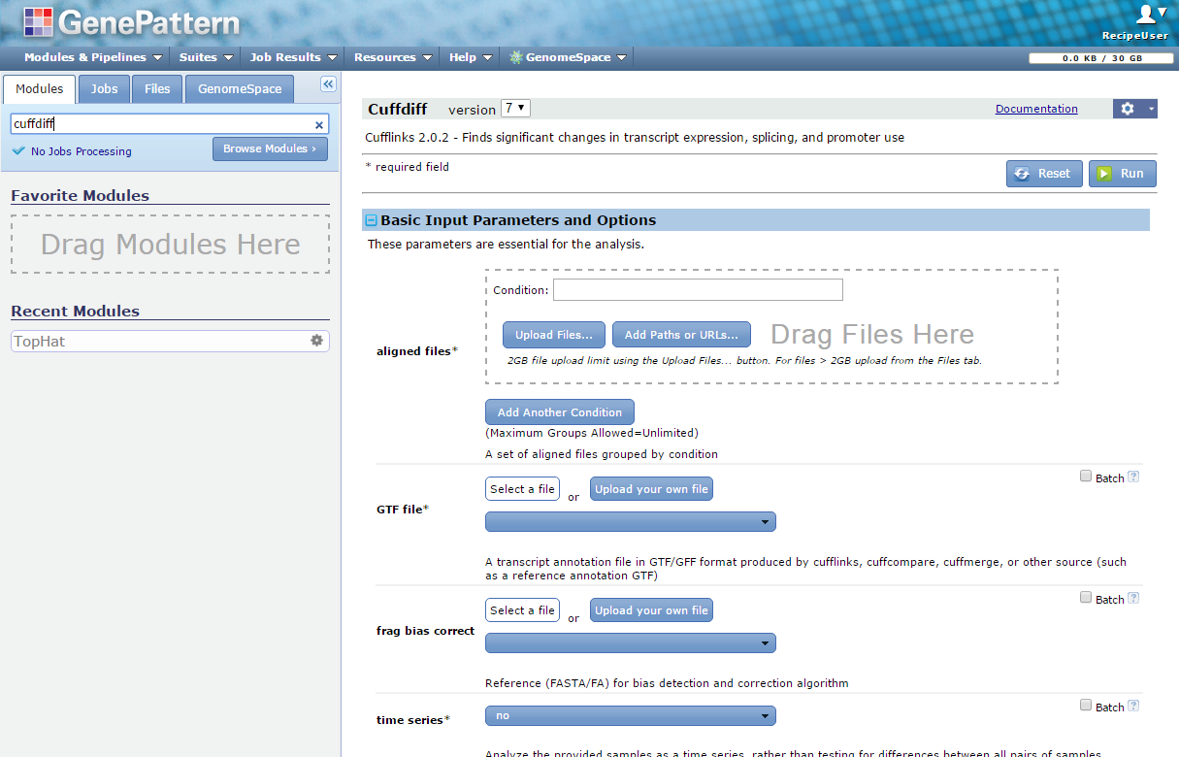
Run Cuffdiff to differentiate phenotypes | FA
Search for “Cuffdiff” under the Modules panel in GenePattern.
Notes:
To run Cuffdiff, we return to the GenePattern WebApp and search for and load the Cuffdiff module.

Slide 31

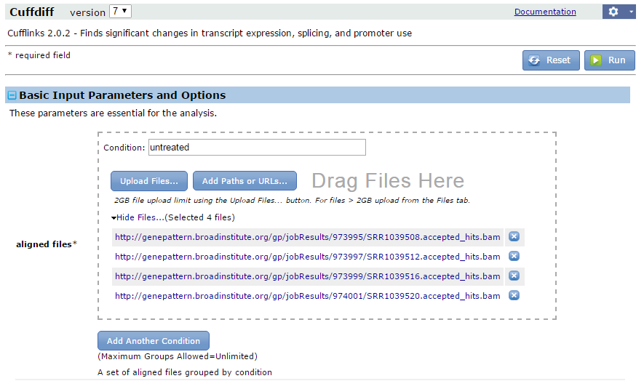
Run Cuffdiff to differentiate phenotypes | FA
Define the first condition (e.g. ‘untreated’), then click .
Then, navigate to shared_data>gp_tutorial_files>2019_BU_MolBio>untreated,
and choose the *.accepted_hits.bam files of that same condition (e.g. SRR…08, SRR…12, SRR…16 and SRR…20).
Notes:
Here we need to first define the phenotypes we’re looking at. Instead of looking at each individual file, we now want to group all the files together and compare them. For this, we separate them into the treatment categories – untreated versus dex-treated. First create the untreated category, then select the untreated files. The files end in 08, 12, 16 and 20.
Next, click ‘add another condition’, change the category to ‘dex’, and add the remaining dex-treated files. These are files ending in 09, 13, 17 and 21
**Shared Files – be sure to be clear about where and how on this, as you’re executing a paradigm shift**
Explain – show that you could have dragged these in from TopHat Jobs
Just want them to see what it looks like so they understand that you can compare many to many.

Slide 32
Run Cuffdiff to differentiate phenotypes | FA
Click Add Another Condition. Define the second condition (e.g. ‘dex’), then click . Go to shared_data>gp_tutorial_files>2019_BU_MolBio>untreated and choose the *.accepted_hits.bam files of that same condition
(e.g. SRR…09, SRR…13, SRR…17 and SRR…21).
Notes:
Here we need to first define the phenotypes we’re looking at. Instead of looking at each individual file, we now want to group all the files together and compare them. For this, we separate them into the treatment categories – untreated versus dex-treated. First create the untreated category, then click and drag the untreated files into the input box. The files end in 08, 12, 16 and 20.
Next, click ‘add another condition’, change the category to ‘dex’, and add the remaining dex-treated files. These are files ending in 09, 13, 17 and 21

Slide 33
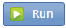
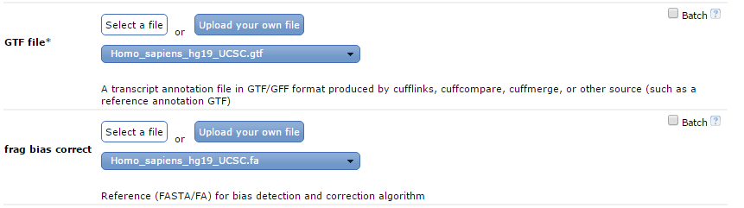
Run Cuffdiff to differentiate phenotypes | FA
Set the GTF file (Homo_sapiens_hg19_UCSC.gtf), the frag bias correct (Homo_sapiens_hg19_UCSC.fa) and the library type (fr-unstranded) parameters. To run the job you would click .
Notes:
Finally, include the reference information so that the expression can be calculated. We need the GTF file, as well as a file to detect fragment biases, and finally we choose the library type. Then we would run this job – once, no batching. We are comparing the groups of samples to each other as groups, rather than iteratively as individuals.

Slide 34
Step 6: Results
Once we determine how the expression of genes/transcripts differs between phenotypes (untreated vs. dex), what next?
Aligned reads and gene expression results can be viewed with IGV.
Differential expression analysis
Cuffdiff
Visualization
Before we continue we’ll take a slight detour to learn how to use IGV.
Notes:
Finally, the very last step – we’ve determined how expression might differ from one phenotype to the next, and we’ve summarized all the data. But we need to visualize it. We can do this in IGV.

Slide 35
Break
Notes:
But first – a break – 15 minutes

